Slide 1

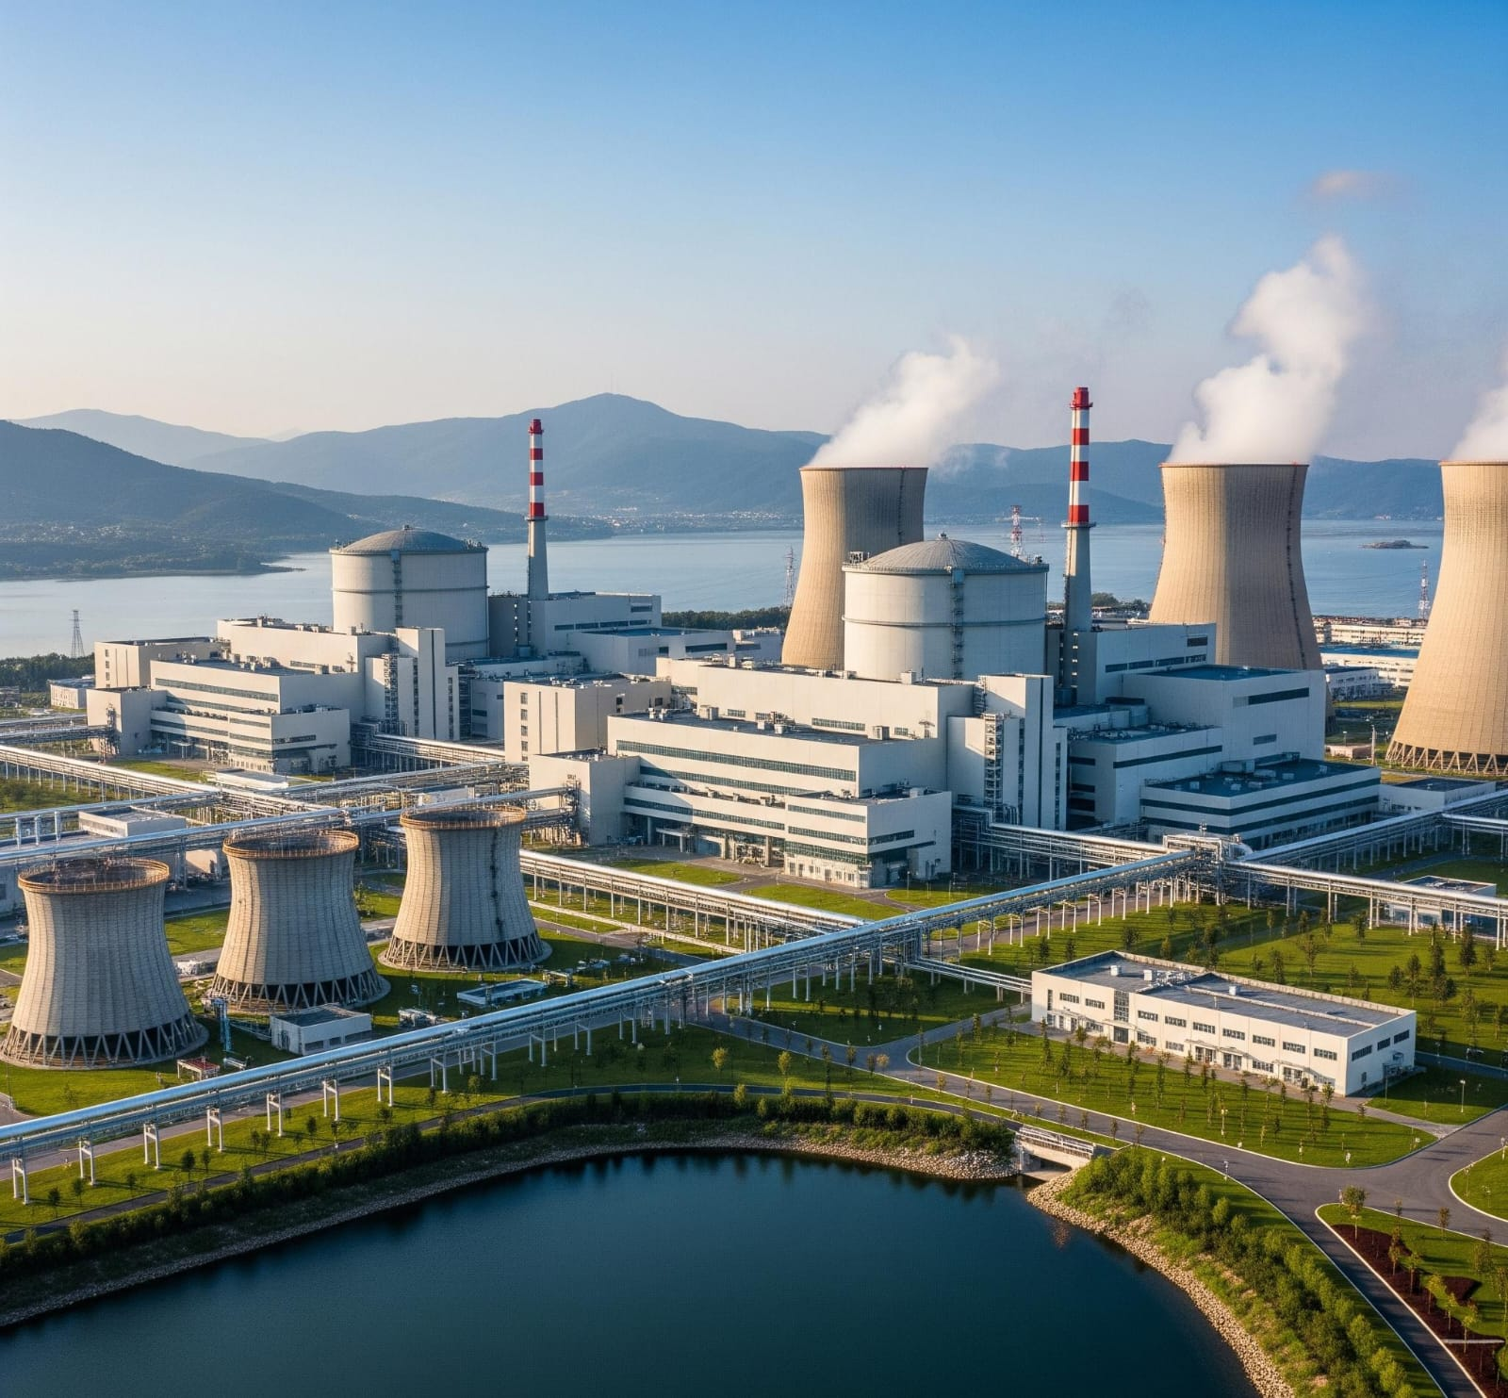
MC 371
ENVIRONMENTAL SCIENCES
CSE-2 BATCH, 3rd SEMESTER, 2025
MCKV INSTITUTE OF ENGINEERING, HOWRAH
NUCLEAR ENERGY
~ PRESENTED BY GROUP 5
(ROLL NO. 118,119,120,121,122,123,124,125,126,127,149)

Slide 2

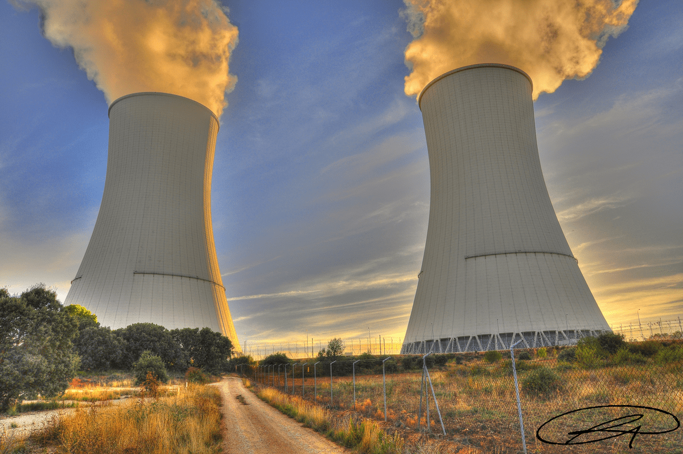
What is Nuclear Energy?
Energy released from the nucleas of atoms during nuclear reactions.
Originates from splitting (fission) or combining (fusion) atomic nuclei.
Produces a large amount of energy with very low greenhouse gas emissions
This Photo by Unknown Author is licensed under CC BY

Slide 3
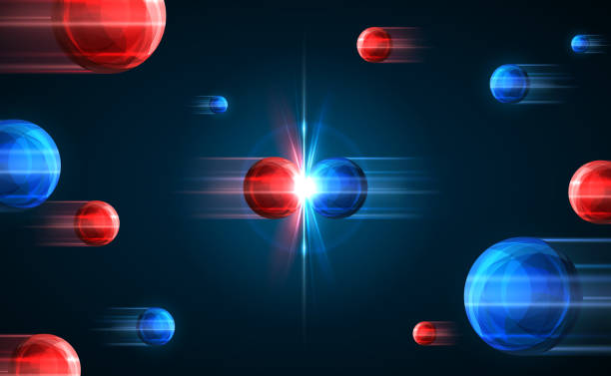
 | Types of Nuclear Reactions Nuclear Fission: Splitting of heavy nuclei(e.g. Uranium-235). Nuclear Fusion: Combining of light nuclei(e.g. Hydrogen isotopes). Currently only Fission is used commercially.

Slide 4

How Nuclear Power Works ?
Fuel Rods
Nuclear
Reactor
Steam
Electricity
Generator
Turbine

Slide 5

Environmental Benefits
Low Greenhouse Gas Emissions.
High Energy output with small footprint.
Reduces dependency on fossil fuels.
Reliable base-load energy.

Slide 6
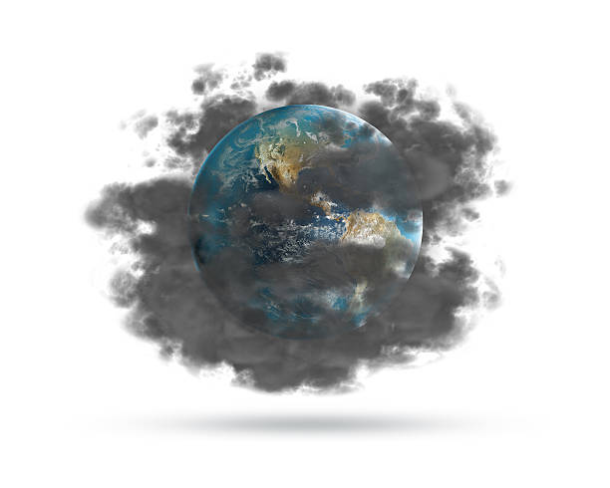
Environmental Concerns
Radioactive Waste – hazardous for thousands of years
Risk of Accidents (e.g., Chernobyl, Fukushima)
Thermal Pollution – impacts aquatic ecosystems
Uranium mining is environmentally damaging

Slide 7
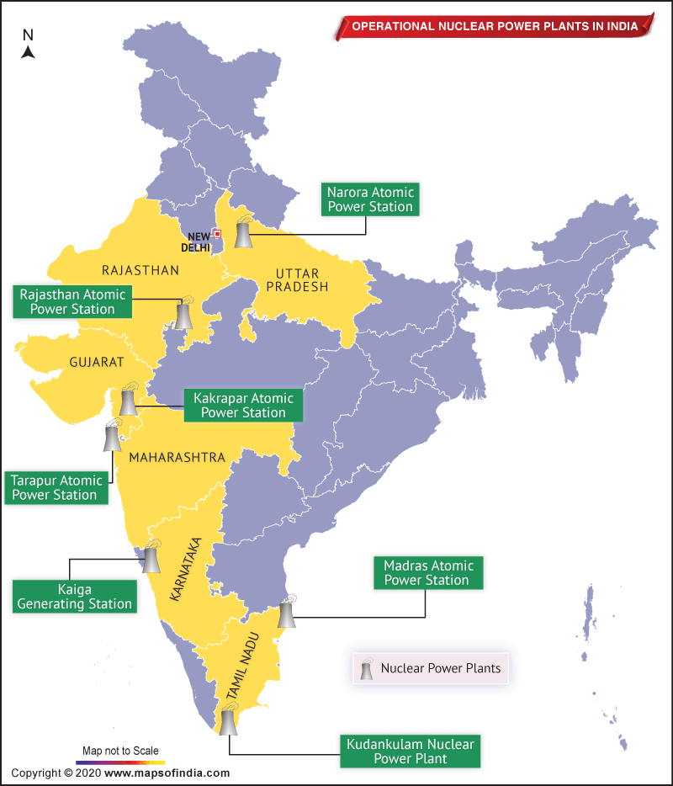
Nuclear Energy in India
India’s nuclear program began in the 1940s under Homi Bhabha.
Controlled by the Department of Atomic Energy (DAE), established in 1954.
India follows a three-step nuclear power programme focused on self-reliance.
Operates 22 nuclear reactors (as of now) with a total capacity of over 7,000 MW.
Major nuclear power plants:
Tarapur (Maharashtra)
Kundankulam (Tamil Nadu)
Kaiga (Karnataka)
Kakrapar (Gujarat)

Slide 8
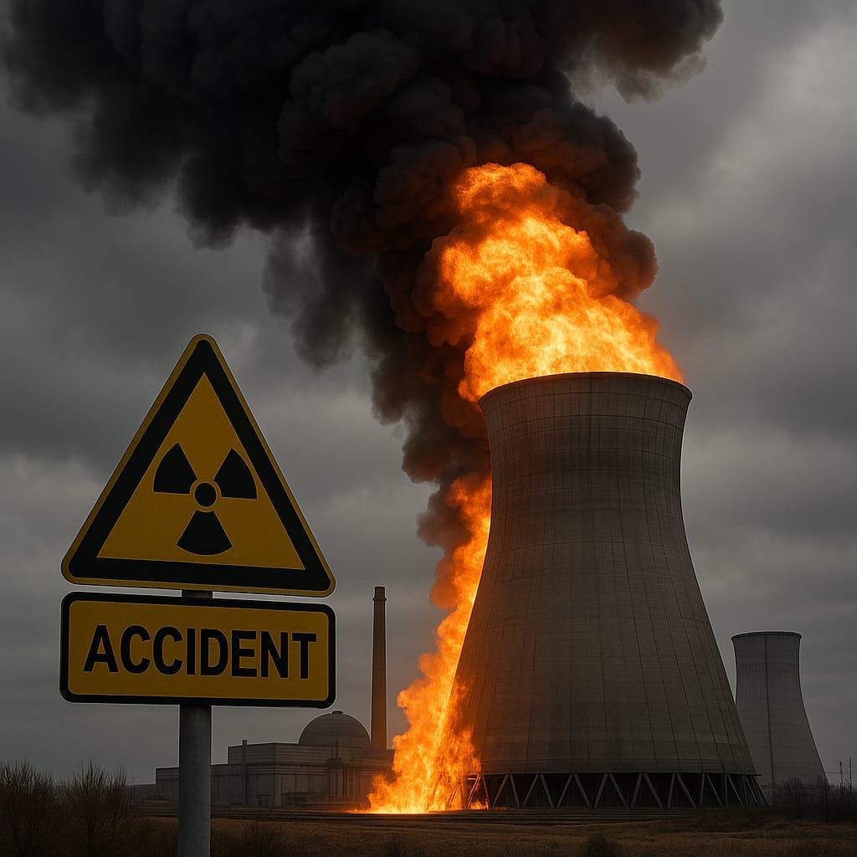
NUCLEAR ACCIDENTS IN INDIA
The only accident to an Indian nuclear plant was due to a turbine hall fire in 1993 at Narora, which resulted in a 17-hour total station blackout. There was no core damage or radiological impact and it was rated 3 on the INES scale – a 'serious incident'.

Slide 9
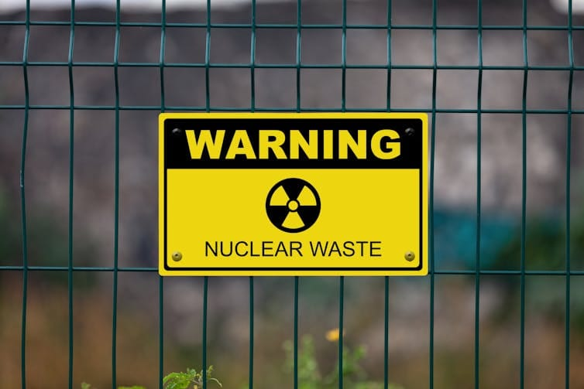
NUCLEAR WASTE MANAGEMENT
India manages nuclear waste through a multi-stage process involving immobilization, interim storage, and eventual disposal in deep geological repositories. The process focuses on vitrification of high-level liquid waste, followed by interim storage for cooling and surveillance before final disposal.

Slide 10
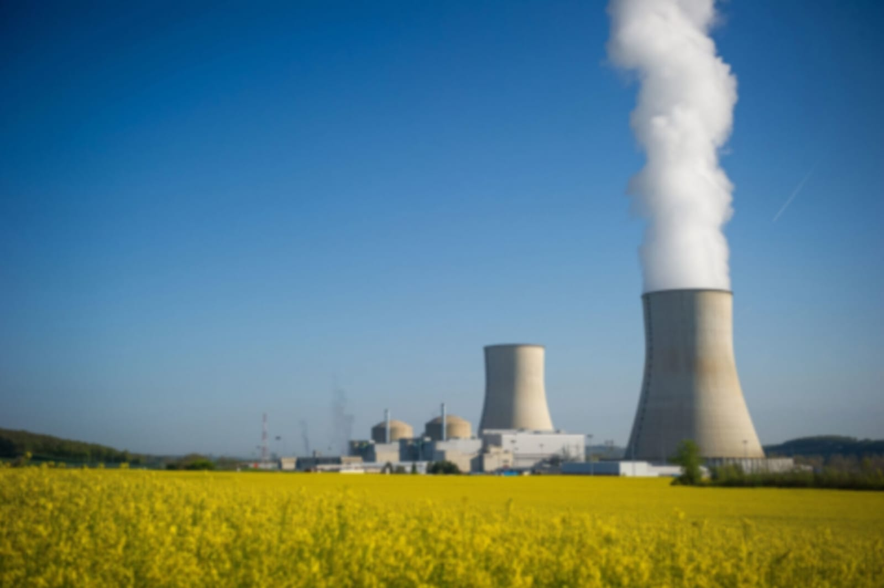
FUTURE SCOPE
India's future nuclear energy landscape holds significant promise for environmental sustainability. By expanding nuclear power, India can significantly reduce its carbon footprint, enhance energy security, and promote sustainable development. Advanced technologies like thorium reactors and small modular reactors (SMRs), along with efficient waste management strategies, are key to achieving these goals.

Slide 11
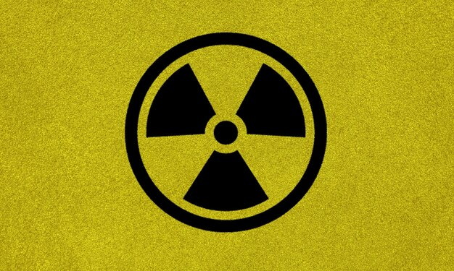
CONCLUSION
Nuclear energy holds significant potential as a low-carbon energy source, but its responsible development requires careful consideration of its risks and challenges. Investing in research and development for safer and more sustainable nuclear technologies, implementing stringent safety regulations, and fostering public trust are crucial for realizing the full potential of nuclear power while minimizing its risks. A balanced approach that considers all energy options, including renewables and energy efficiency, is essential for a sustainable energy future.

Slide 12
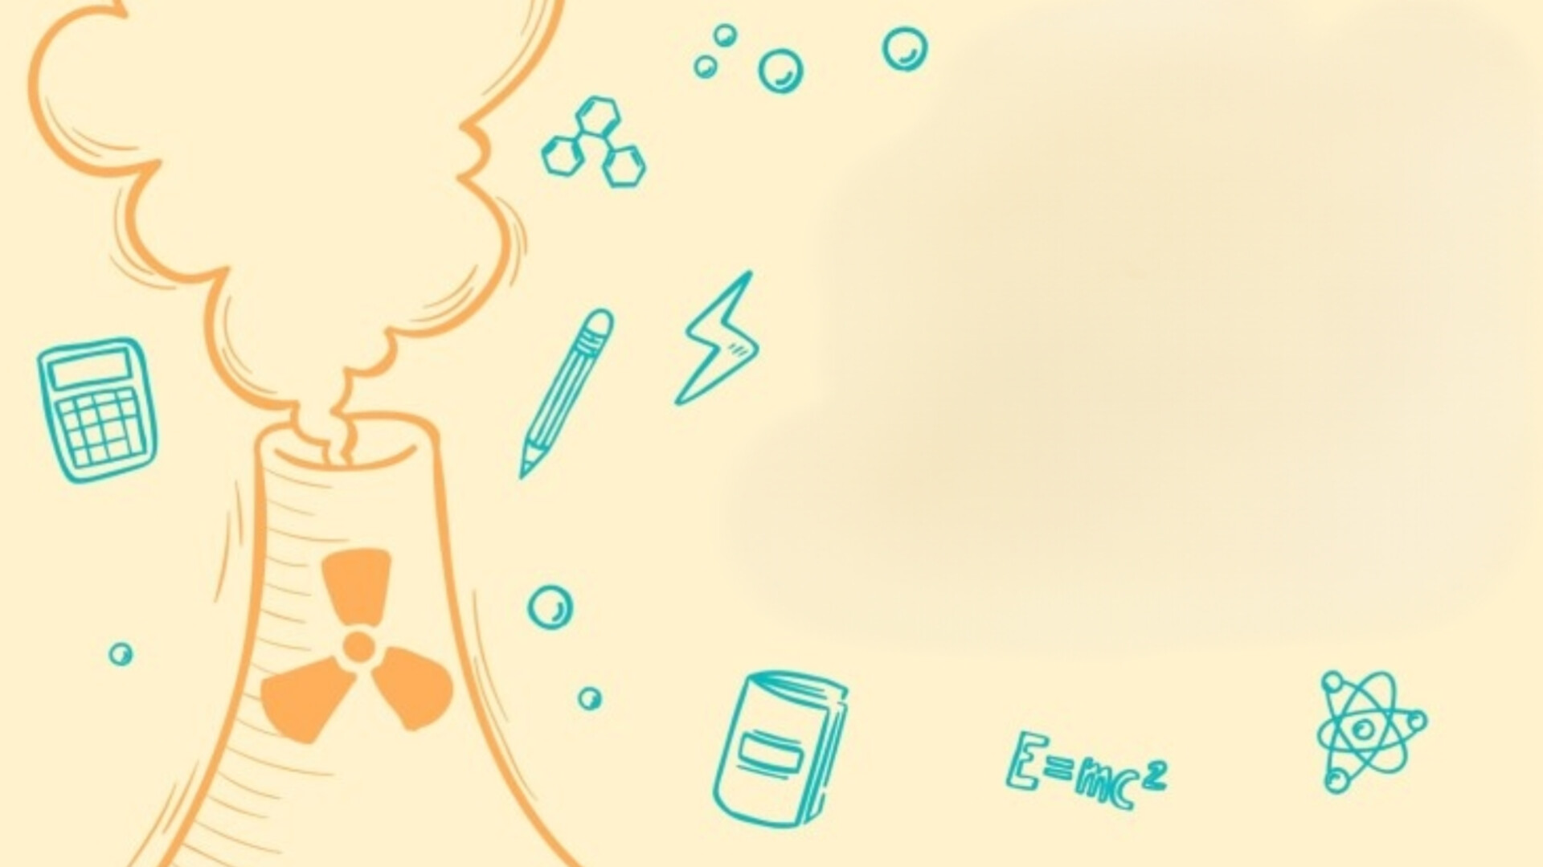
REFERENCES
https://www.energy.gov.in
https://www.world-nuclear.org
https://www.sciencedirect.com
https://www.orfonline.org

Slide 13

THANK YOU !

